Slide 1


WEEK 8
SPRINT 3
PL6
REQ

Slide 2


about us.

Slide 3
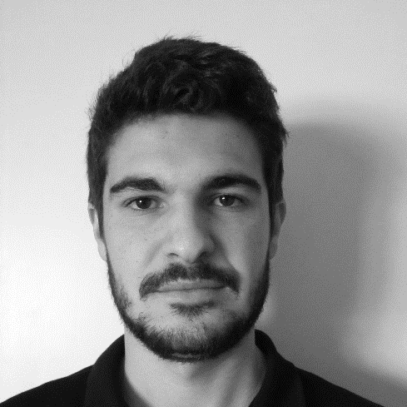
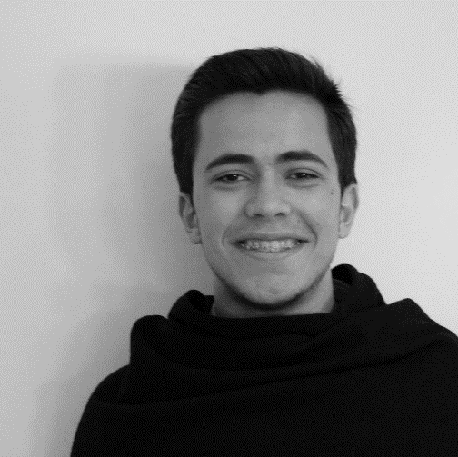
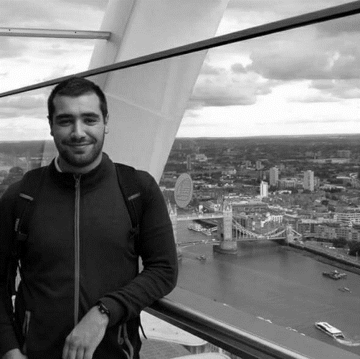

req.
Emanuel
Marco
Paulo
Nuno

Slide 4
tasks.
 | TASK #1 | TASK #2 | TASK #3 | TASK #4
TASK | Update Mockups | Update requirements document | Weekly presentation | Meeting with the client
OWNER | Nuno | Emanuel, Marco, Paulo | Marco | Emanuel, Paulo
GOAL EFFORT | 3 H | 4 H | 1 H | 1 H 00
EFFECTIVE EFFORT | 4 H | 3 H 30 | 0 H 40 | 0 H 40
STATUS | COMPLETED | COMPLETED | COMPLETED | COMPLETED

Slide 5
planned tasks.
 | TASK #1 | TASK #2
TASK | Update Mockups | Inspection -Requirements document | Revision – Quality Manual
OWNER | Nuno | Team | Emanuel, Marco, Paulo
GOAL EFFORT | 2 H 30 | 4 H | 2 H 30
STATUS | NEW | NEW | NEW

